Slide 1
THIRD YEAR RESEARCH PROJECT Computational Evolution: Antibiotic Resistance
Paris-Anne O’Shea & Hameed Khandahari

Slide 2
Antibiotics: The Magic Bullet
Chemical substance which inhibits the reproduction of other microorganisms.
When introduced in the 1940s, they dramatically reduced the numbers and severity of illness and death from bacterial infections such as pneumonia. [1]
Notes:
Ventola, C. L. (2015). The Antibiotic Resistance Crisis: Part 1: Causes and Threats. Pharmacy and Therapeutics, 40(4), 277–283.

Slide 3
How do Antibiotics Work?
When the bacteria divides, it must temporarily create “holes”.
The “holes” are then filled in with proteins.
Antibiotics kills bacteria by inhibiting these proteins.
Bacteria cannot fill in the “holes” left in its cell wall.
Water rushes in.
Pops from the turgor pressure. [2]
Notes:
When the bacteria divides, it must temporarily create “holes” in its cell wall to allow for growth and separation of the daughter cells. The “holes” are then filled in with freshly synthesized peptidoglycans.
Penicillin kills bacteria by inhibiting the proteins which cross-link peptidoglycans in the cell wall
When a bacterium divides in the presence of penicillin, it cannot fill in the “holes” left in its cell wall.
The bacterium is so filled with solutes compared to the surrounding solution that the water rushes in, and without a full cell wall to support the bacterium, t “pops” from the turgor pressure

Slide 4
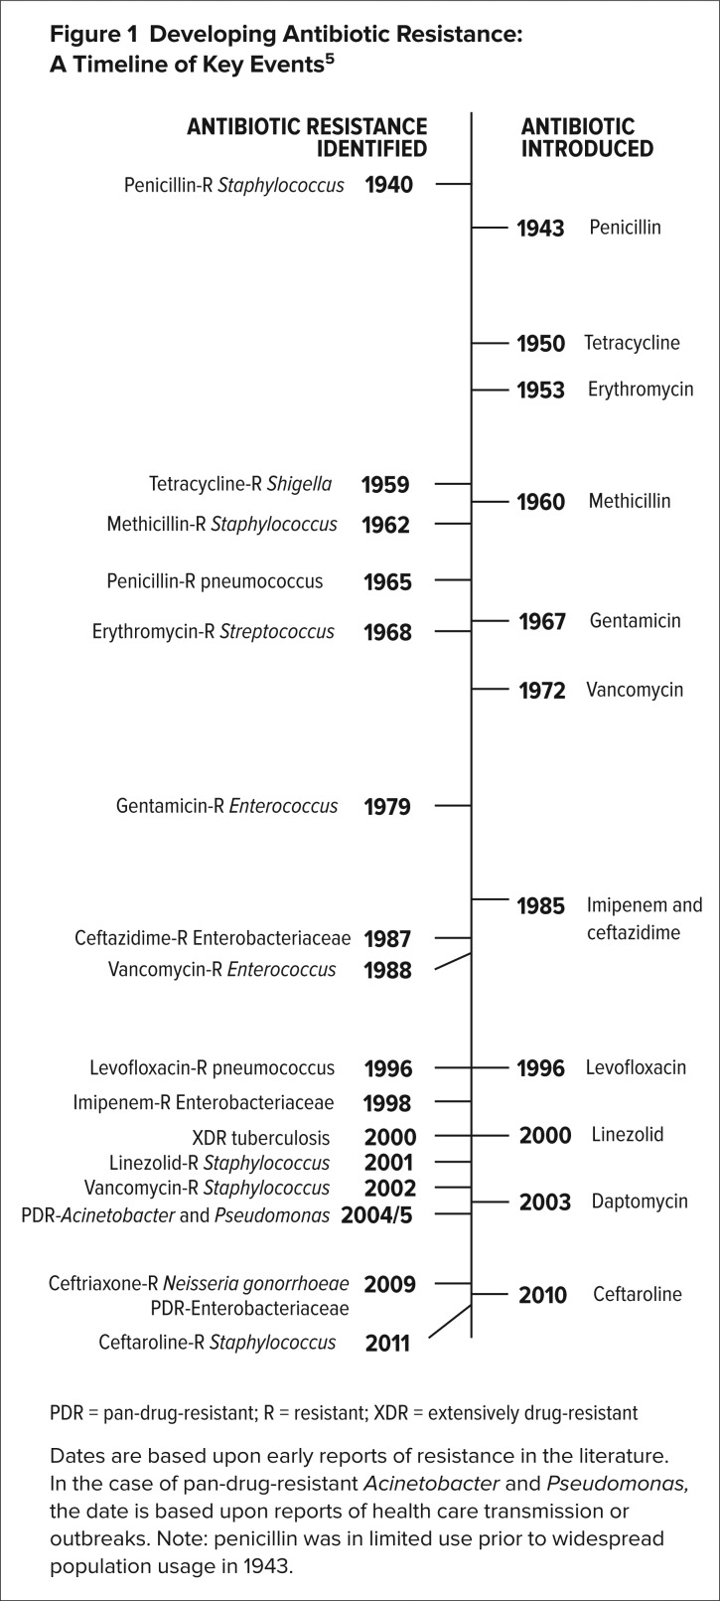
Antibiotic Resistance
As early as 1945, Sir Alexander Fleming raised the alarm regarding antibiotic overuse when he warned that the “public will demand [the drug and] … then will begin an era … of abuses.” [3]

Slide 5
Causes of Resistance
Number of New Antibiotics Decreasing[4]
Overuse of Antibiotics[4]
Agricultural Use[5]
Figure 4 Transfer of Resistant Antibiotics
Antibiotics per course: $1,000 Cancer chemotherapy: $10,000+
Over the counter purchase: not regulated - Overuse
70% of all antibiotics manufactured are used in agricultural
Notes:
Newer antibiotics are generally priced at a maximum of $1,000 to $3,000 per course compared with cancer chemotherapy that costs tens of thousands of dollars.
Ventola, C. L. (2015). The Antibiotic Resistance Crisis: Part 1: Causes and Threats. Pharmacy and Therapeutics, 40(4), 277–283.
Heilig, S., Lee, P., & Breslow, L. (2002). Curtailing antibiotic use in agriculture: It is time for action: this use contributes to bacterial resistance in humans. Western Journal of Medicine, 176(1), 9–11.
The number of new anitbiotics developled and approved has decreased steadily over the past three decades leaving fewer options to treat resistant bacteria.

Slide 6
Methods of Resistance
Produce the enzyme B-lactamase that destroys the antibiotic’s structure
Dormancy
Change shape
Notes:
: When bacteria are dormant, they essentially go to sleep—instead of growing, they simply sit idle. While in this state, antibiotics aren't able to kill them because they won't be absorbed. Change their dormancy period to match the time that antibiotics were administered https://www.nature.com/articles/nature13469

Slide 7
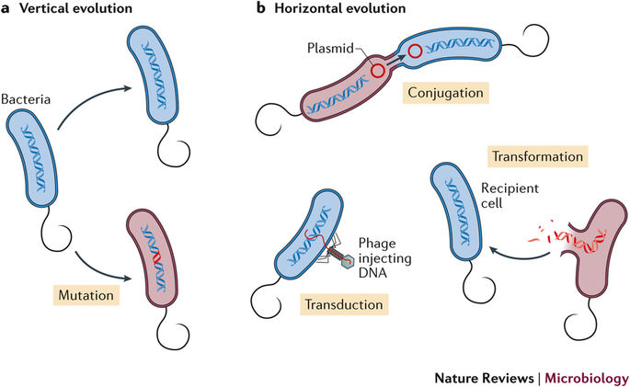
Evolution
[6]
a. Mutations: 0.03% per gene per reproduction
b. Horizontal Gene Transfer
Notes:
Nature Reviews Microbiology 15, 689–696(2017)
doi:10.1038/nrmicro.2017.75

Slide 8
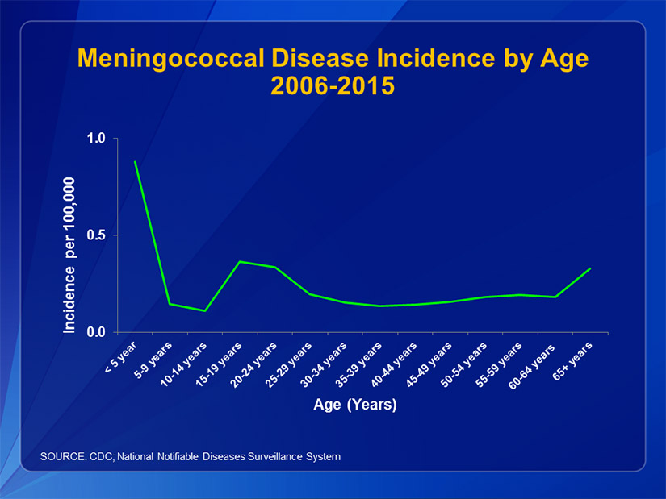
Meningococcal Meningittus
Simplest bacteria type: Cocci
50% of all cases occur with babies
One in four 15-19 year olds carry the bacteria in the back of their throats. Compared to 1 in 10 usually.
10% of young people & children die. [7]
[5]

Slide 9
Methodology: Agent-based modelling
Environment
Bacteria
Antibiotics
Food
Concentration
Concentration
Half Life
Key
Dormancy Frequency
Dormancy Period
Number of Offspring
Generation
Dimensions
Reproduce Level
Food Level
Resistance
Frequency

Slide 10
Simulation Logic
Add food
Add bacteria
Set clock
Initialise environment
Add antibiotics?
START
Dormant?
die()
move()
10% chance of mutation of any gene
food level decreases
== 0
Food Level?
reproduce()
> Reproduce level
Bacteria position == Antibiotics position?
Bacteria resistant?
not resistant
resistant
Bacteria position? == food position?
eat()
Notes:
Add finish point?
Psuedo code: environment, add_agents, add food etc

Slide 11
Possible Mutations
Gene | Fitness Cost
Antibiotic Resistance | Reproduce Level += one eat
Number of Offspring | Reproduce Level += 2 eats for each additional child
Dormancy Duration | The longer the dormancy the less time the bacteria has to eat and hence reproduce
Dormancy Frequency

Slide 12
Model v Real-Life
Real life | Approximation
Binary Fission | 90% of reproduction is binary
Resistance: vertical, horizontal, dormancy | Resistance: dormancy, vertical
Vertical Transfer Antibiotic Resistance 0.03% per gene per generation [8]. | 10% per generation
Horizontal Transfer Antibiotic Resistance | Combined in vertical transfer percentage
Antibiotic Course Duration | 10 equally spaced doses

Slide 13
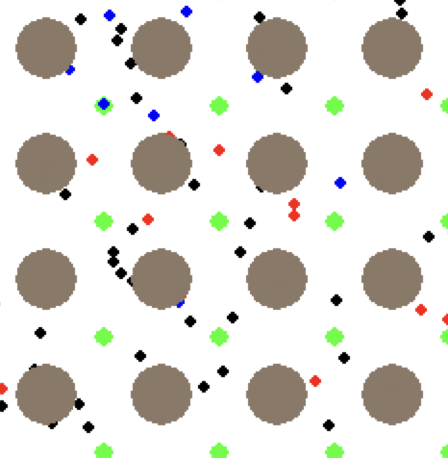
resistant bacteria
antibiotics
food
non-resistant bacteria
dormant bacteria

Slide 14
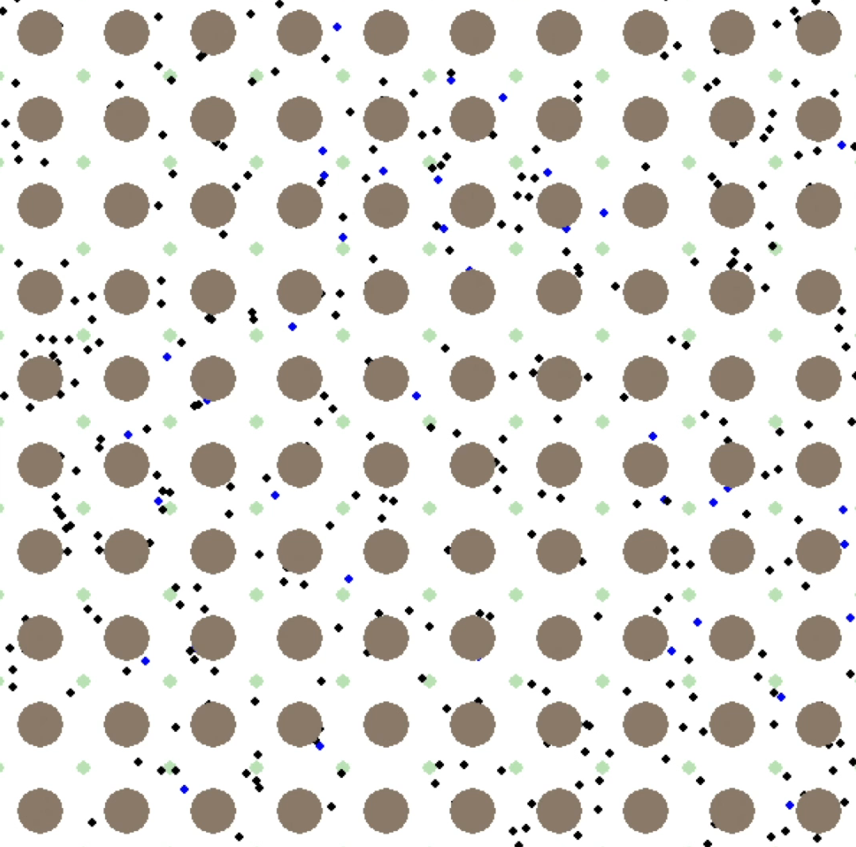
Simulation
Resistant Agents
Antibiotics
Food
Non-resistant Agents
Dormant Agents

Slide 15
Set-up
Normal Carrier
On average 1 in 10 people are a carrier of meningococcal bacteria
Set up immune system to balance
N = 200e^{γt} – 0.1N
Without immune System
N = 200e^{γt}
Control Antibiotics
Set the antibiotic parameters to kill the bacteria after 10 equally spaced doses
Infected Carrier
Initial number of bacteria multiplied by 2.5
N = 500e^{γt} – 0.1N
Population: 500
Immune System: 10% / 2500
Antibiotics:
halflife – 4000
frequency – 16000
# doses – 10
Population: 500
Immune System: 10% / 2500
Population: 200
Immune System: 10% / 2500
Population: 200
Notes:
Just labels?
Slide for each and then this as the summary?
Find decay constant

Slide 16
Control Antibiotics
Notes:
Check to make sure it is as expected
Exponential decay of antibiotics
Dirac immune system
Low level starvation

Slide 17
Finishing the Course Early

Slide 18
5 doses
3 missed doses
4 doses
Antibiotics Compensation
Stop
Start
Stop
Start
Start
Start

Slide 19
Weak Immune System: Finishing Early

Slide 20
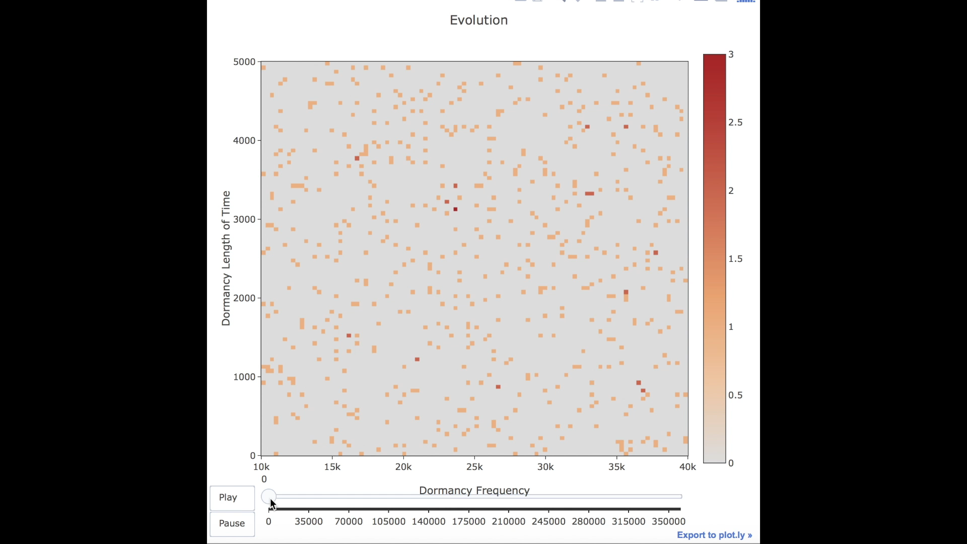
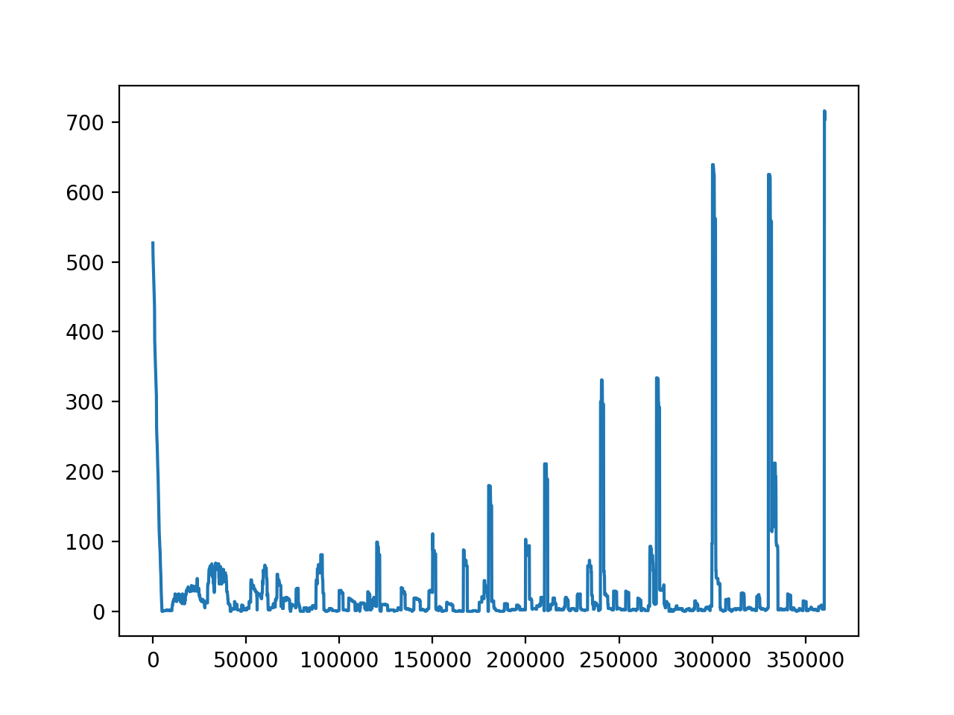
Evolution of Dormancy: Type 1
30, 000
Number of Agents Dormant
10, 000
Antibiotics Concentration: 0.01
Antibiotic frequency: 10000
Antibiotic Half Life: 800
Dormancy Time: 0 – 5000
Dormancy Frequency: 10000 - 40000
Time Elapsed

Slide 21
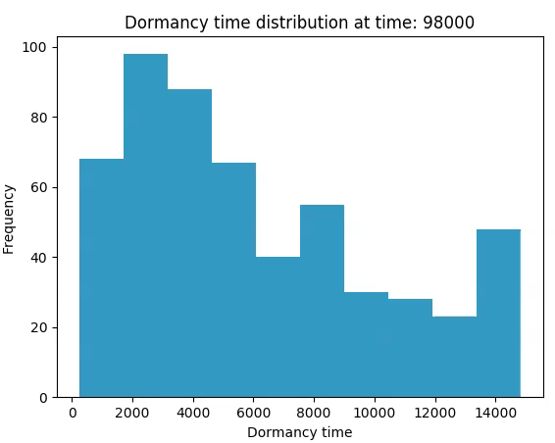
Evolution of Dormancy: Type 2
Antibiotics Half-Life: 1600

Slide 22
Implications of Project
Software for Medical Research
Antibiotics Resistance Forecast
Deciding Optimum Dosage
Distribution by WHO for Educational Purposes
Extended to Analyse Different Genes

Slide 23
Conclusion
Finishing course more than 4 doses early will result in a antibiotics being ineffective
Compensation using further antibiotics after missing more than 2 doses will result in increasing the antibiotic resistance
The rate of evolution is highly dependent on the strength of the immune system
Dormancy frequency of the bacteria will be forced into oscillation with the antibiotics frequency
Dormancy period close to the halflife of the antibiotics is optimum for survival

Slide 24
References
[1] Ventola, C. L. (2015). The Antibiotic Resistance Crisis: Part 1: Causes and Threats. Pharmacy and Therapeutics, 40(4), 277–283.
[2-4] Heilig, S., Lee, P., & Breslow, L. (2002). Curtailing antibiotic use in agriculture: It is time for action: this use contributes to bacterial resistance in humans. Western Journal of Medicine, 176(1), 9–11.
[5] Nature 513, 418–421 (18 September 2014) doi:10.1038/nature13469
[6] Nature Reviews Microbiology 15, 689–696(2017) doi:10.1038/nrmicro.2017.75
[7] Martinez, J. L., & Baquero, F. (2000). Mutation Frequencies and Antibiotic Resistance. Antimicrobial Agents and Chemotherapy, 44(7), 1771–1777.
[8] Munita, J. M., & Arias, C. A. (2016). Mechanisms of Antibiotic Resistance. Microbiology Spectrum, 4(2), 10.1128/microbiolspec.VMBF–0016–2015. http://doi.org/10.1128/microbiolspec.VMBF-0016-2015

